Slide 1
E – COMMERCE WEBSITE
PROJECT TITLE

Slide 2
E – COMMERCE WEBSITE
STUDENT NAME : ASWIN H
REGISTER NO : 24bsai113
NMID : 72B5936F0EBB34A8C574F04A21364EAD
DEPARTMENT : B.SC ARTIFICIAL INTELLIGENCE AND MACHINE
LEARNING
COLLEGE : SRI KRISHNA ADITHYA COLLEGE OF ARTS AND SCIENCE UNIVERSITY : BHARATHIYAR UNIVERSITY

Slide 3

AGENDA
Problem Statement
Project Overview
End Users
Tools and Technologies
Portfolio design and Layout
Features and Functionality
Results and Screenshots
Conclusion
Github Link

Slide 4

PROBLEM STATEMENT
To design and develop a E - Commerce website that showcases Home page , product page and etc.
Using this website , we can purchase products in online

Slide 5

PROJECT OVERVIEW
A single-page responsive website built with HTML, CSS, and JavaScript.
Sections include:
Home page
Product details and images
Contact Us link
About Us
Quick links

Slide 6
WHO ARE THE END USERS?
Customers (Buyers) .
Sellers (Vendors/Business Owners).
Administrators (System Admins).

Slide 7

TOOLS AND TECHNIQUES
Frontend Languages:
HTML – Structure of the webpage
CSS – Styling and layout
JavaScript – Interactivity (form submission, smooth scroll, etc.)
CodePen – Development and live preview
Image Hosting: i.ibb.co

Slide 8
E – COMMERCE WEBSITE IDEA
Header Section – Title
About Me Section – Home page
Contact Section – Contact form with Name, Email, Phone, Send button
Footer – Copyright

Slide 9
FEATURES AND FUNCTIONALITY
Responsive design – Works on desktop & mobile
"View My Work" button links to Projects section
Contact form with input fields (Name, Email, Phone)
Footer auto-updates with current year using JavaScript
Simple, modern, and user-friendly layout

Slide 10
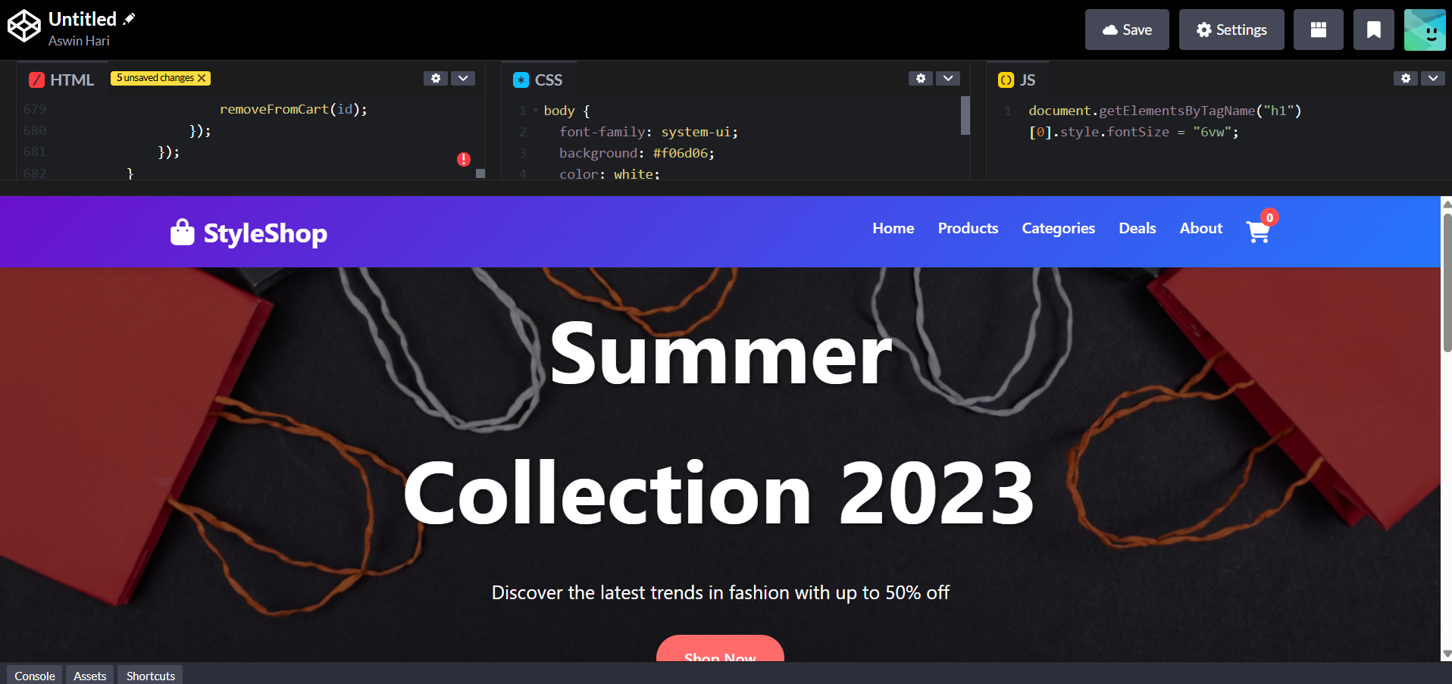
RESULTS AND SCREENSHOTS

Slide 11

CONCLUSION
Successfully built a E - Commerce website using HTML, CSS, and JavaScript.
Provides a professional online presence.
Can be enhanced with:
Dark/Light mode
More projects
Integration with backend/email service for real form submission

